Slide 1
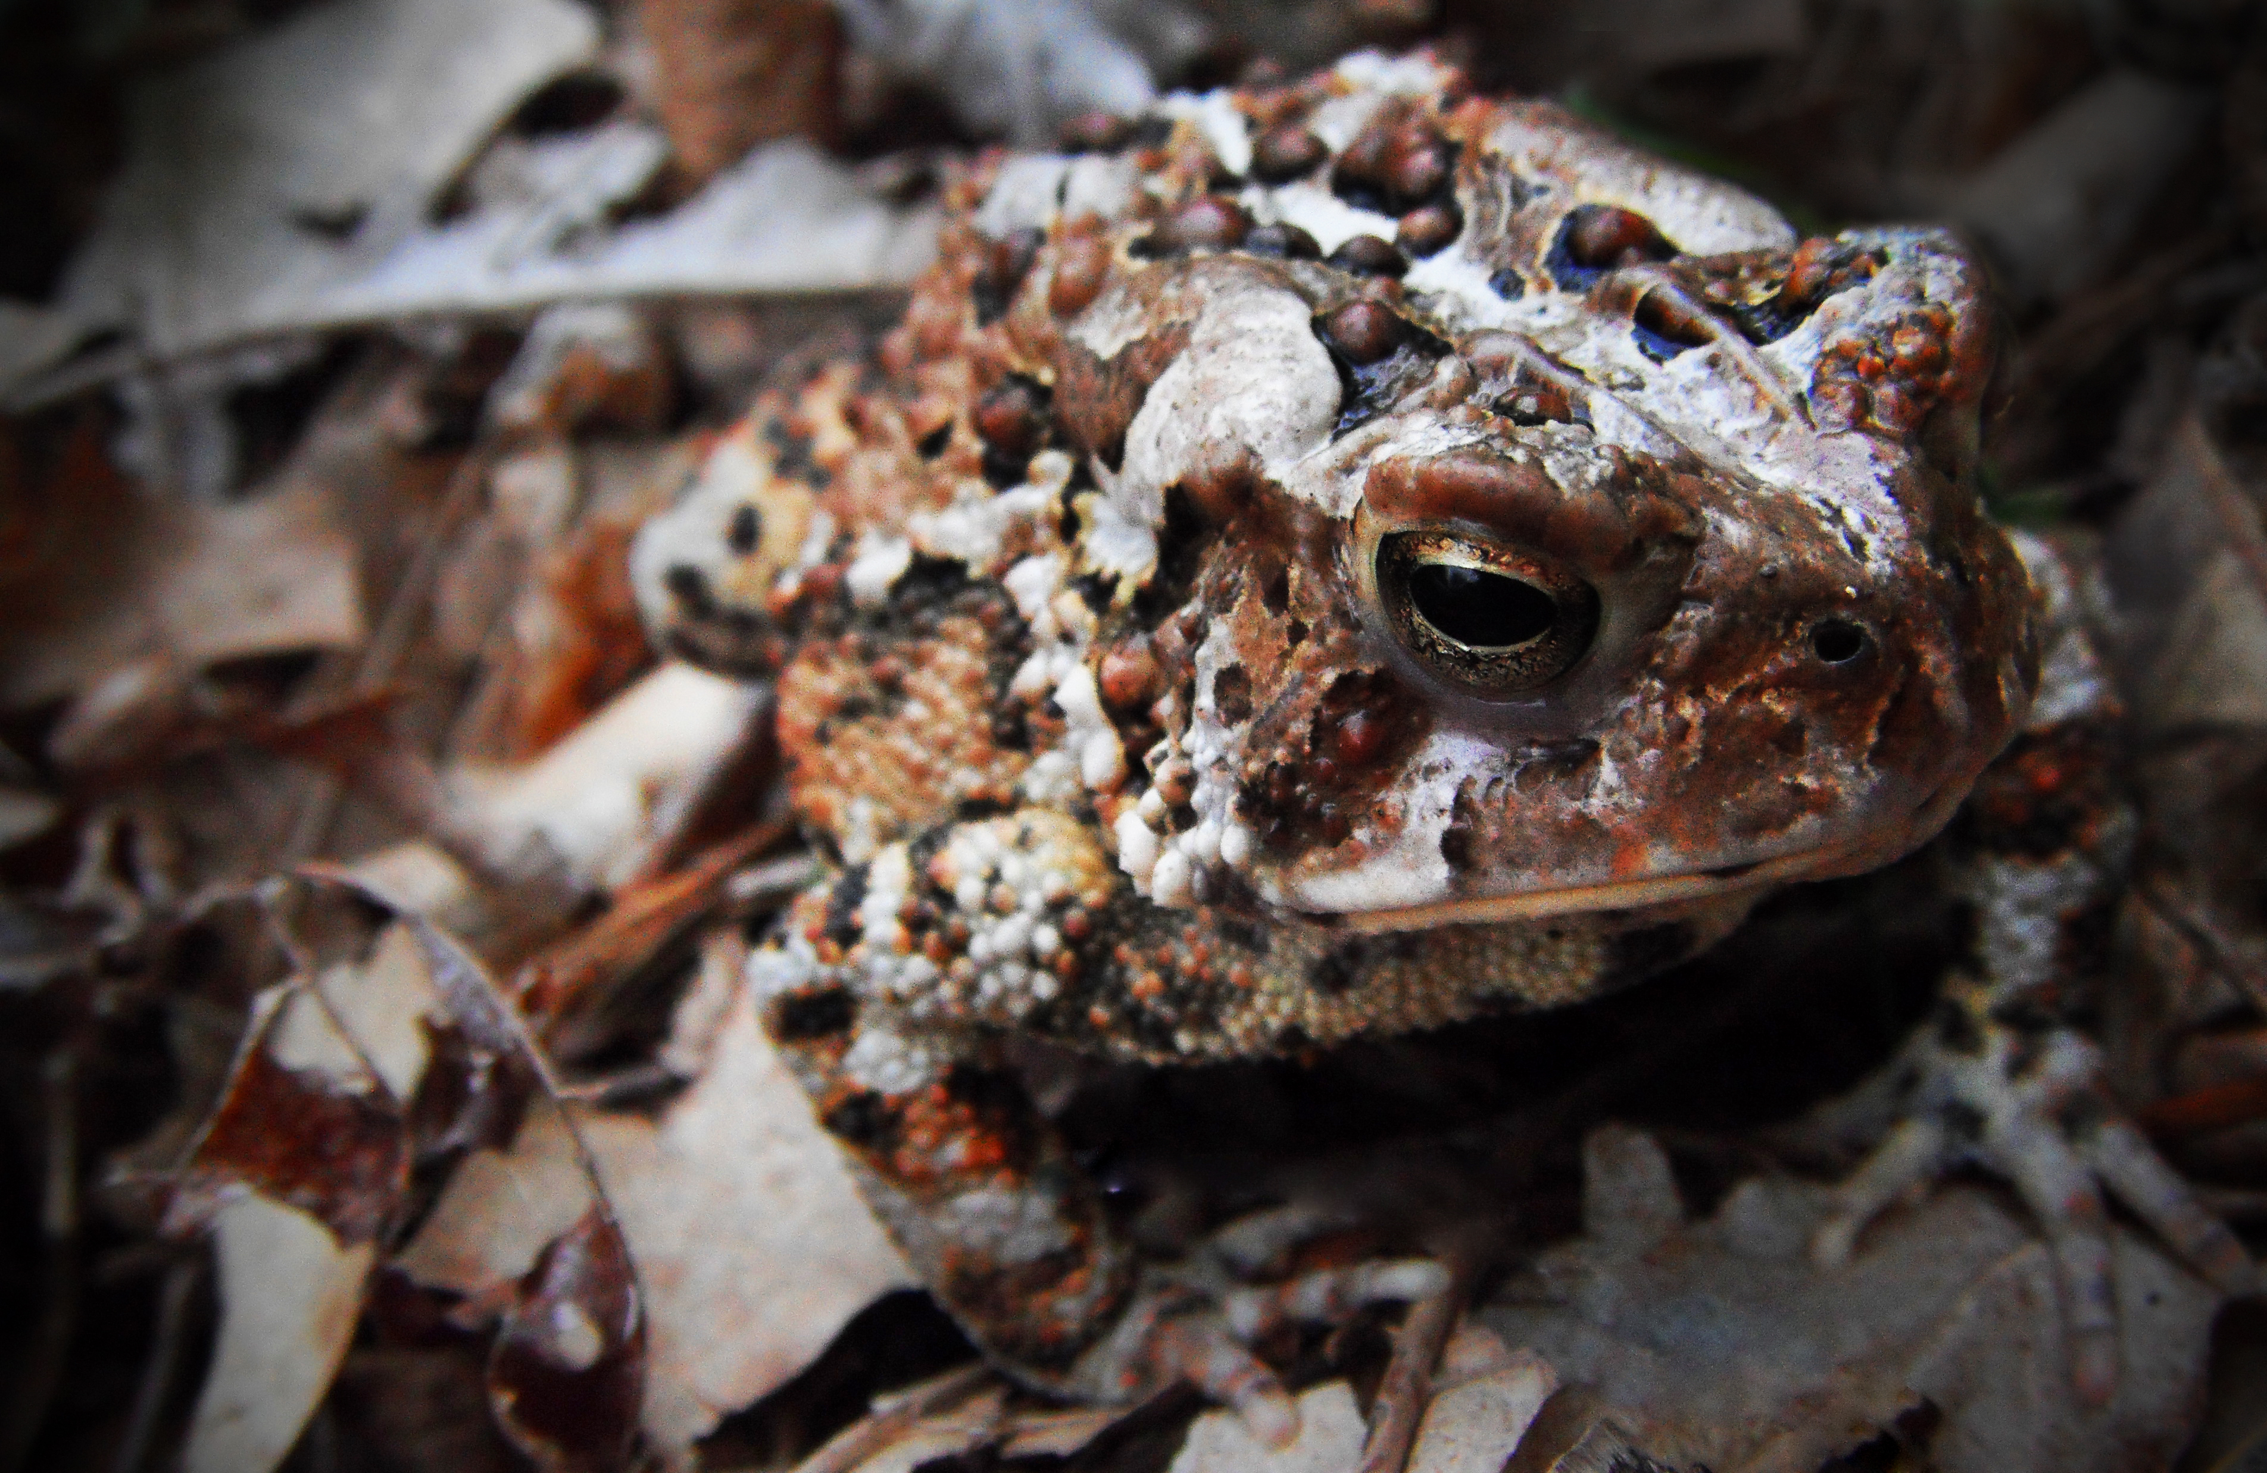
Making the most of citizen science

Slide 2
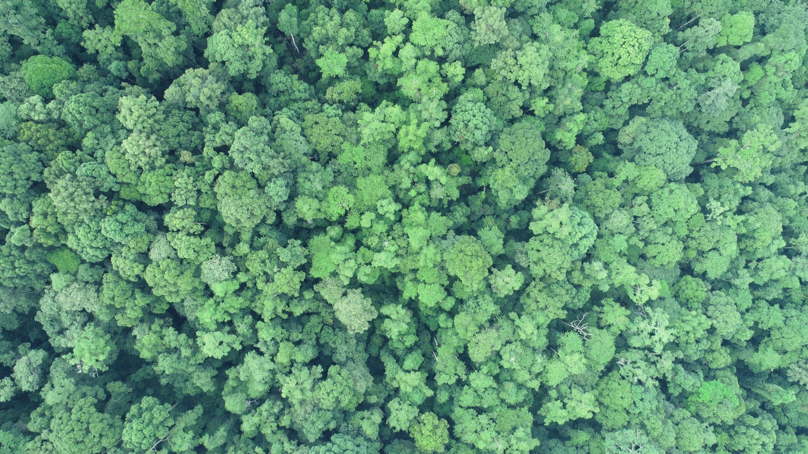
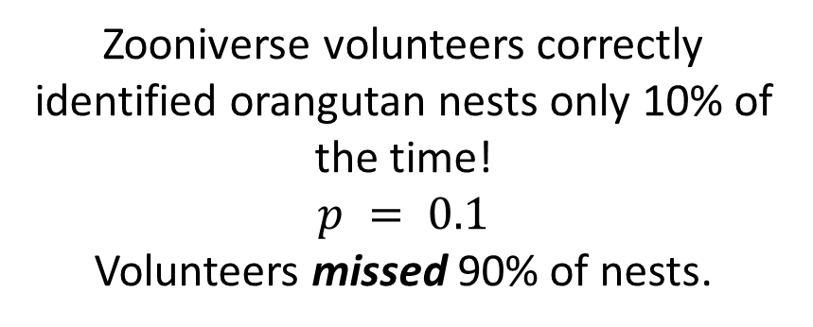
Zooniverse volunteers correctly identified orangutan nests only 10% of the time!
$$p = 0.1$$
Volunteers missed 90% of nests.

Slide 3
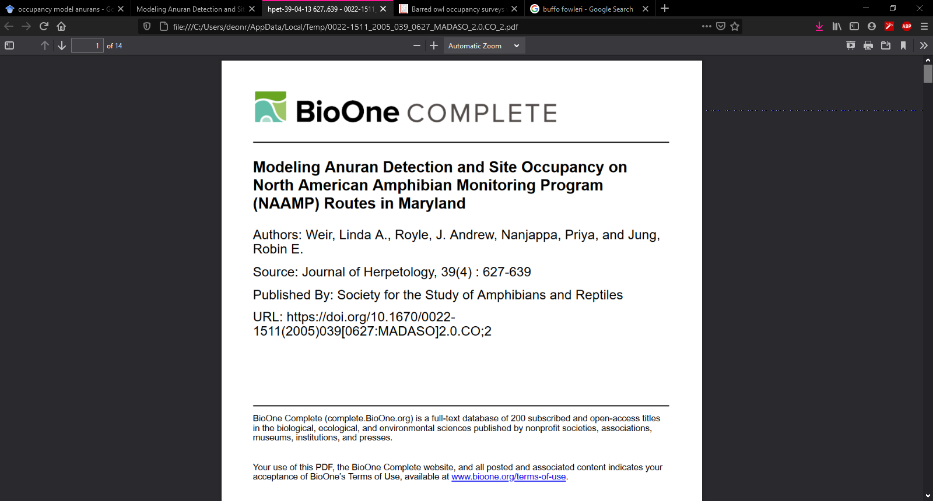
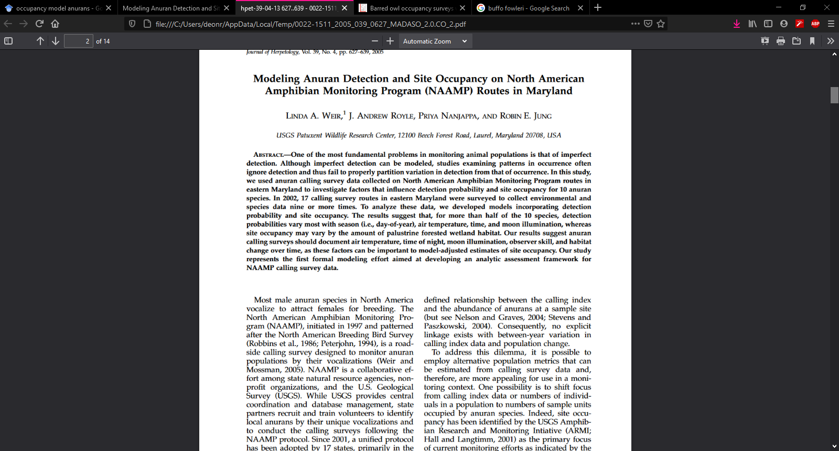
Citizen science data of frogs

Slide 4

Using citizen science to monitor frogs
Group interested in frogs
Concerned about population trend
Male anurans vocalise to attract females for breeding
Skilled volunteers can identify the species based on vocalisations
Surveys done by state organisations and NGOs
Coordination and data storage managed by USGS

Slide 5
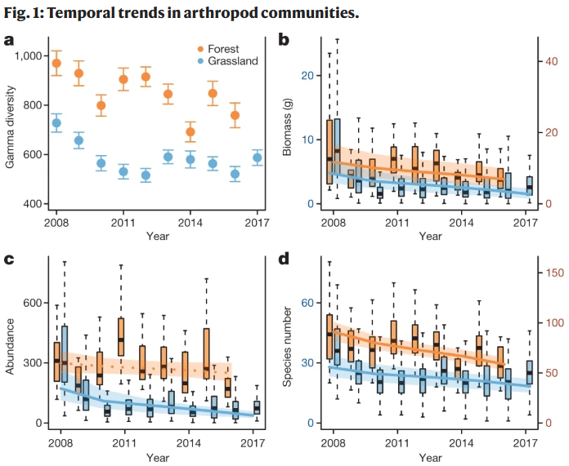
NAAMP’s concern; Are frog species declining?
Is there a problem we need to do something about?
At what scale are populations changings?
How wide spread is the problem?
Suggestion from wider literature that we are in mass extinction event
Note that Nature “insectageddon” paper has faced many criticisms

Slide 6
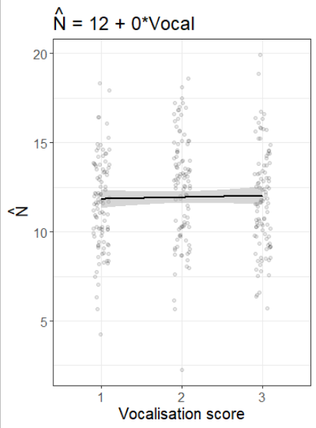
NAAMP originally wanted a population index
A surveyor would listen to vocalisation and give a score;
From 1, indicating individuals calling with no overlap
To 3, a full chorus
Idea was that this could be used to estimate abundance
But no relationship found
Switch to presence/absence

Slide 7
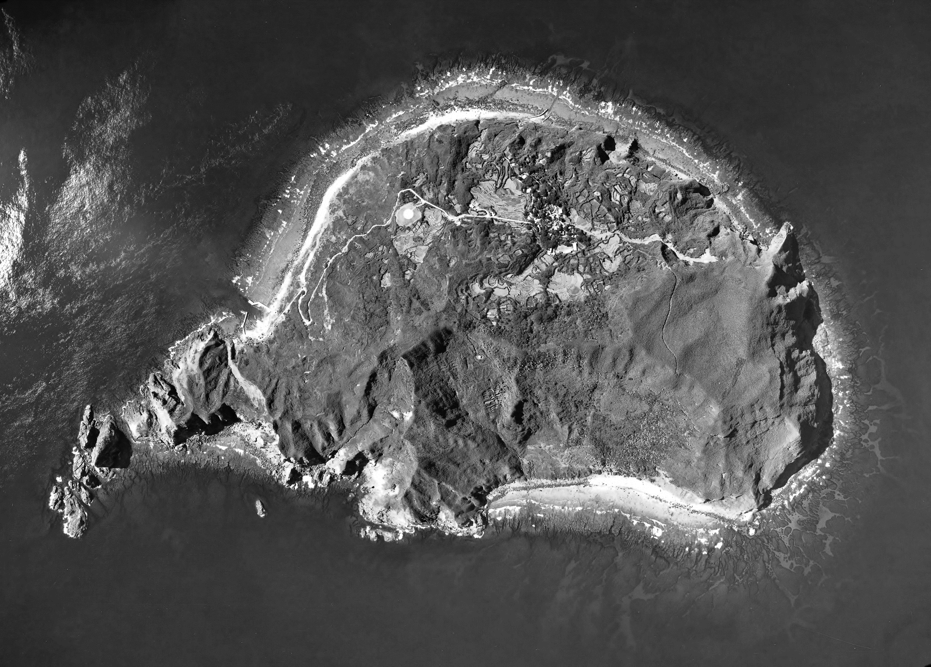
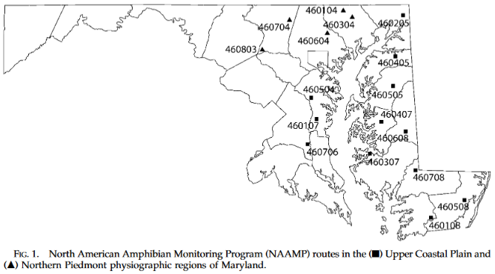
A considered sampling design
Stratified random sampling design
Stratified by two habitat types
17 locations
Each with 10 sites
3 seasons
March, April/May and June
3 surveys per season

Slide 8
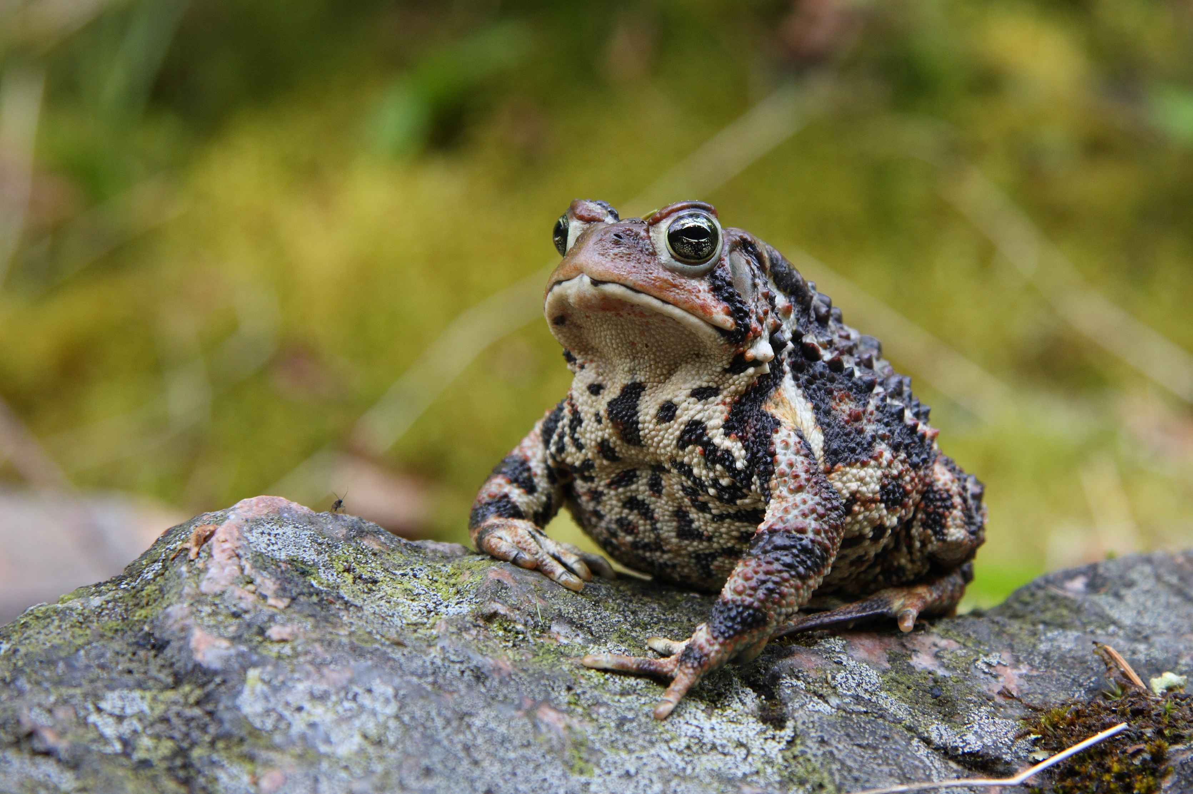

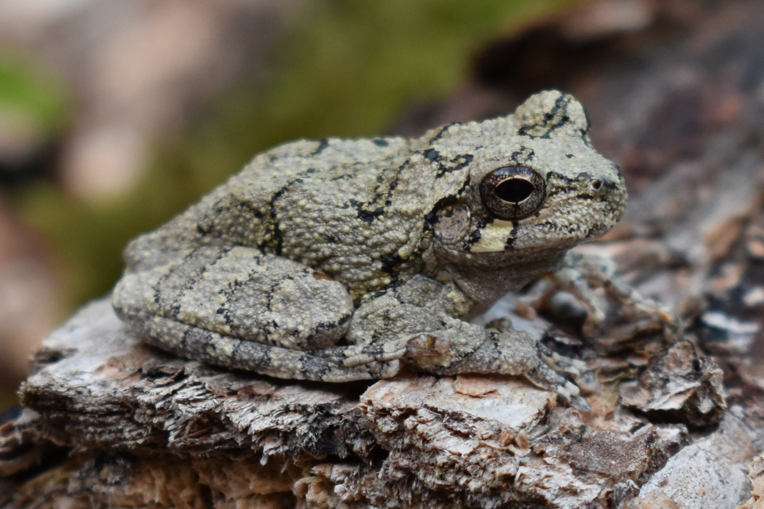
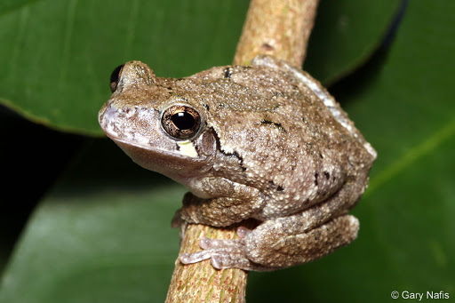
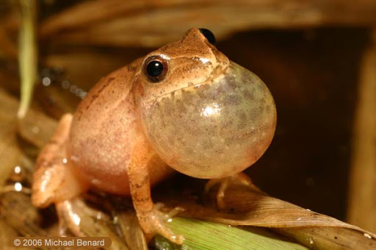
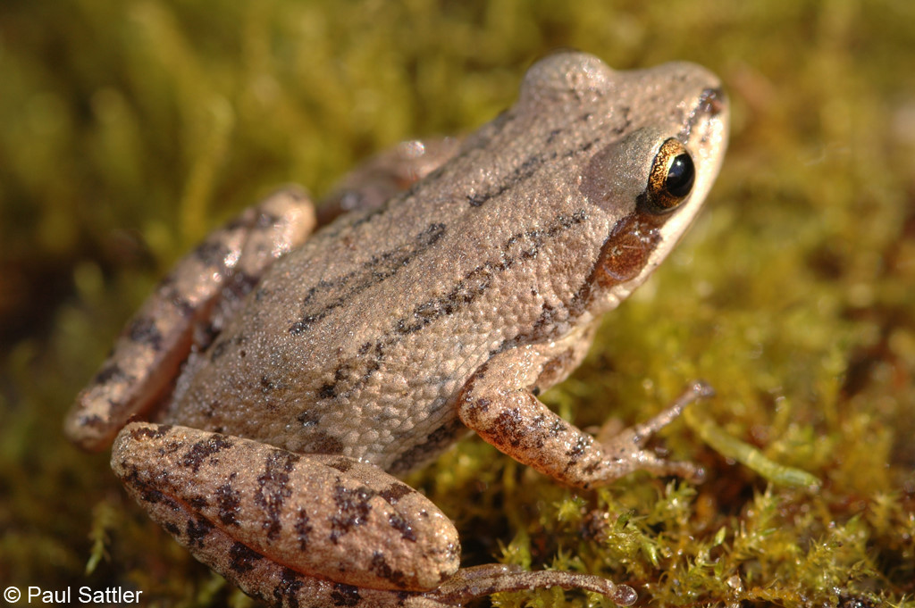
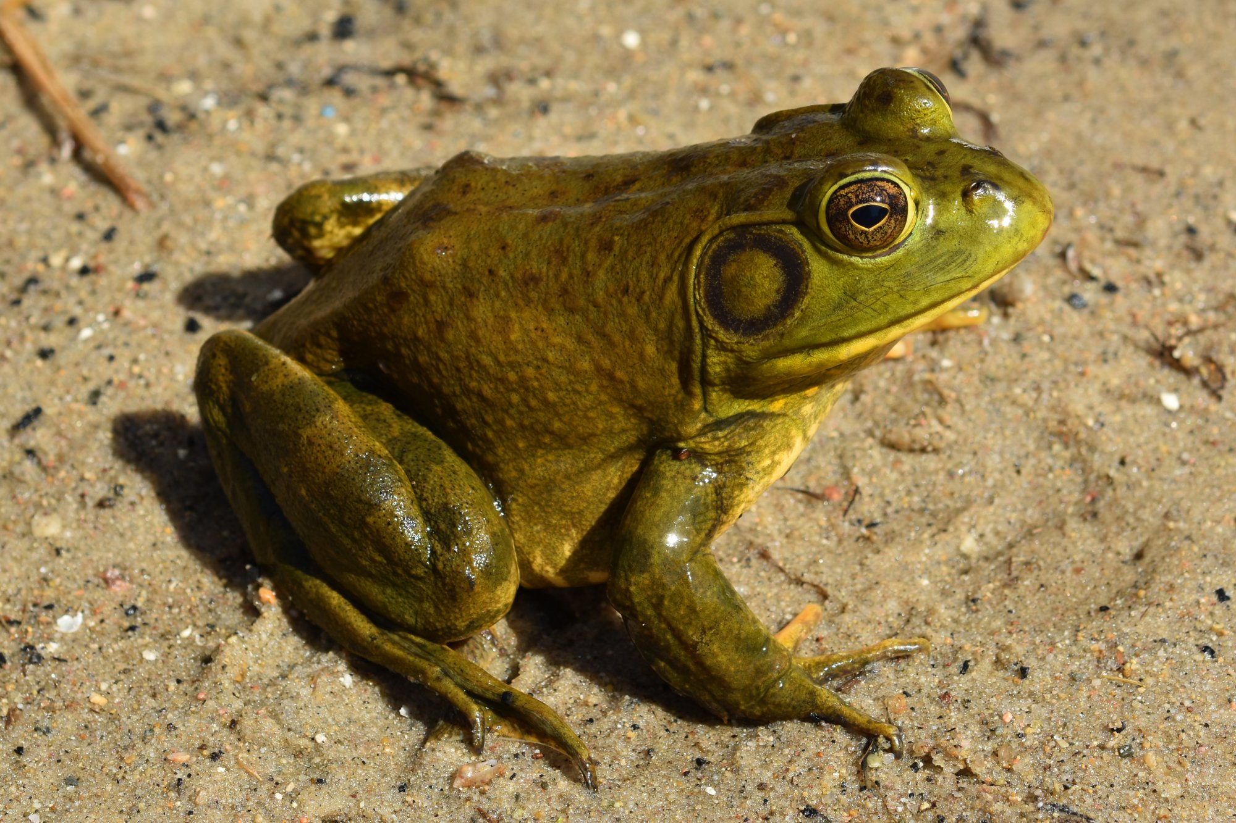
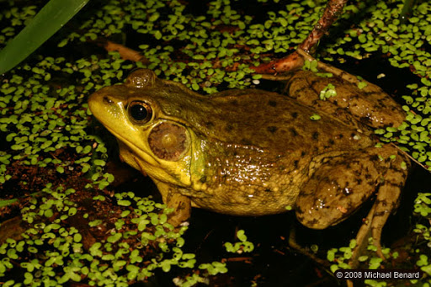
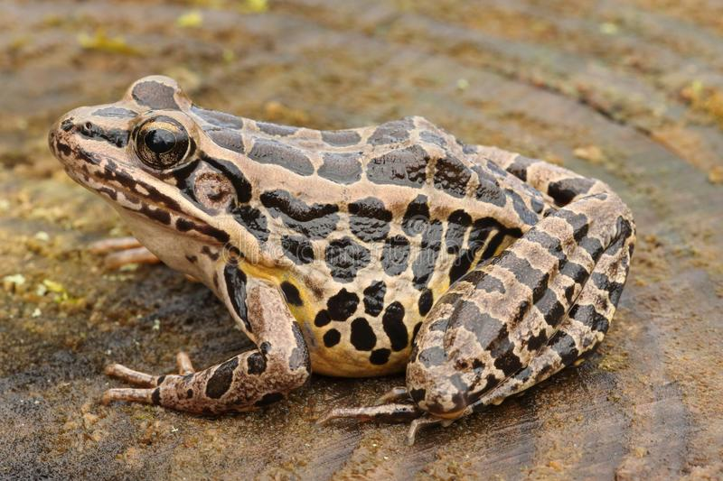
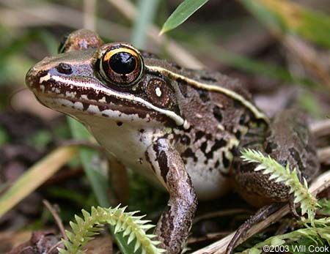
A survey method designed to maximise inference
Identify which anuran species were present
19 species in total
10 species observed
Each of the 17 location had 10 “listening” sites, surveyed 3 times in 3 seasons
17 * 10 * 3 * 3 = 1530 samples
Listening stops separated by 0.8 km
Prevents double counting
Chose sites close to potential breeding areas
“But without regard to the initial presence/absence of calling anurans”

Slide 9
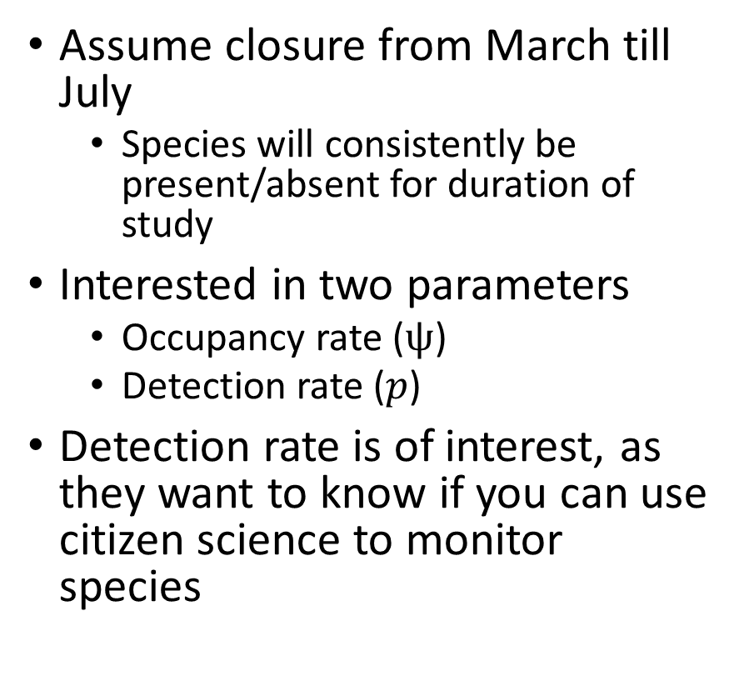
Single season occupancy model
Assume closure from March till July
Species will consistently be present/absent for duration of study
Interested in two parameters
Occupancy rate ($ψ$)
Detection rate ($p$)
Detection rate is of interest, as they want to know if you can use citizen science to monitor species
101
000
100
000
111
000

Slide 10
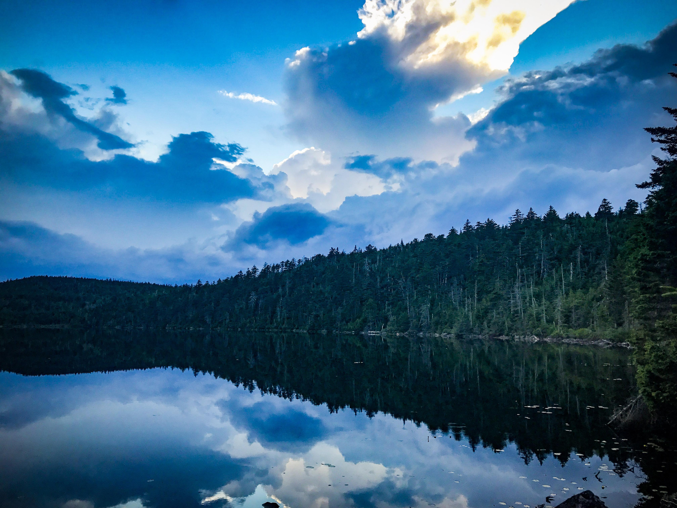

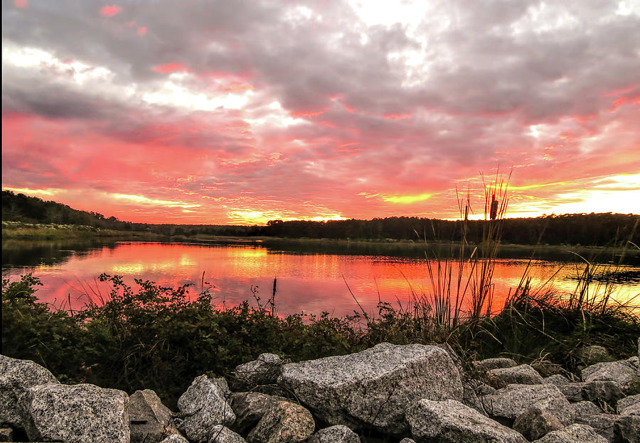
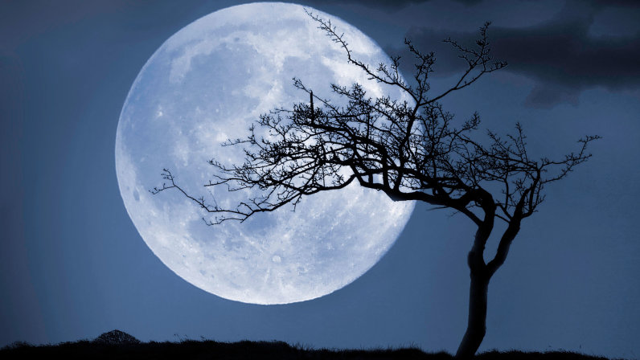
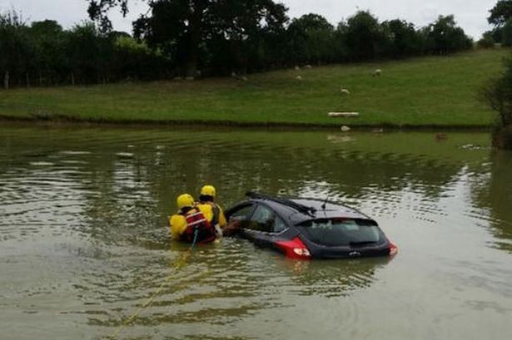


Interested in what influenced detection ($p$)
All might affect whether a frog vocalises. Since detection depending on whether a frog vocalised, all these may affect detection
What time did survey take place?
How many cars drove past?
What was the lunar phase?
How much cloud cover was there?
Plus an interaction between lunar phase and cloud cover
Had it rained in the last 48 hours?
$$logit\left(p_{i}\right)=α_{1}+α_{2}Date_{i}+α_{3}Cars_{i}+α_{4}Lunar_{i}+α_{5}Cloud_{i}+α_{6}Lunar_{i}Cloud_{i}+α_{7}Rain_{Yes}$$

Slide 11
Interested in what influenced detection ($p$)
$$logit\left(p_{i}\right)=α_{1}+α_{2}Date_{i}+α_{3}Cars_{i}+α_{4}Lunar_{i}+α_{5}Cloud_{i}+α_{6}Lunar_{i}Cloud_{i}+α_{7}Rain_{Yes}$$
The intercept
Effect of cars
Effect of clouds
When there was rain, how did our intercept change
Combined effect of moon and clouds
Effect of date
Effect of lunar phase

Slide 12
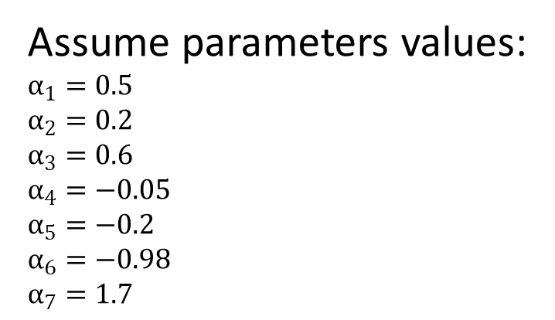
Understanding equations
(Observer experience was also included in this model)
$$logit\left(p_{i}\right)=α_{1}+α_{2}Date_{i}+α_{3}Cars_{i}+α_{4}Lunar_{i}+α_{5}Cloud_{i}+α_{6}Lunar_{i}Cloud_{i}+α_{7}Rain_{Yes}$$
$$logit\left(p_{e}.g.Site1\right)=0.5+0.2∗21+0.6∗4+−0.05∗0.84+−0.2∗12+−0.98∗0.84∗12+1.7∗1$$
Data in field notebook for Site 1:
21 days into year
4 cars drove past
Moon was 0.84 full
Clouds score of 12
It had rained in past 24 hours (1)
Assume parameters values:
$$α_{1}=0.5$$
$$α_{2}=0.2$$
$$α_{3}=0.6$$
$$α_{4}=−0.05$$
$$α_{5}=−0.2$$
$$α_{6}=−0.98$$
$$α_{7}=1.7$$

Slide 13
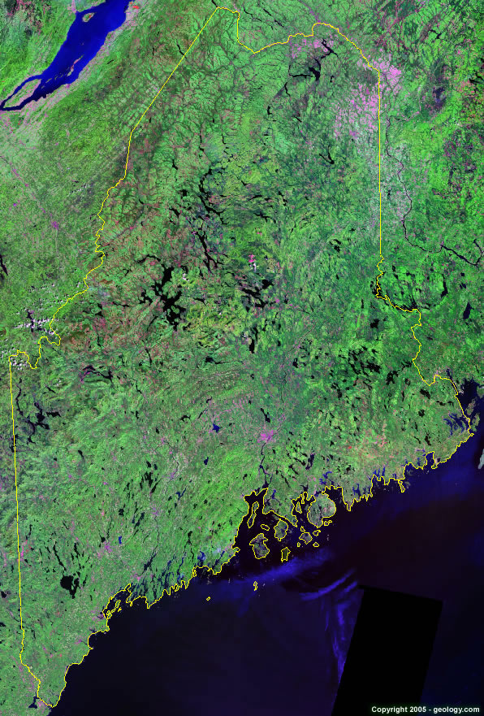

What influenced occupancy ($ψ$)?
What is the habitat types within 1 km of the listening stop?
Natural
Agricultural farmland
Developed
What type of wetland was present at a site?
Estuarine
PEM (i.e. small ponds)
Palustrine (i.e. big ponds)
Open water (i.e. lakes)
$$logit\left(ψ\right)=β_{1}+β_{2}Agri+β_{3}Dev+β_{4}Est+β_{5}Pond+β_{6}BigPond+β_{7}Open$$

Slide 14
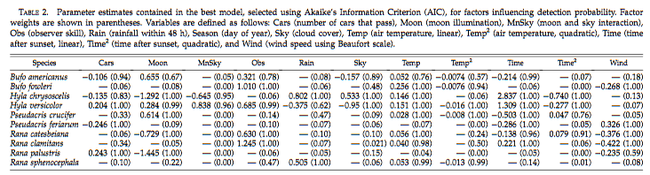
What influenced detection?
Detection of particular species does not have a constant explanation
Varies between species
E.g. rain increases chance of detecting H. chrysoscelis, has no effect for most species (-), but has a negative effect on H. versicolor
Observer experience important for detecting 50% of species

Slide 15
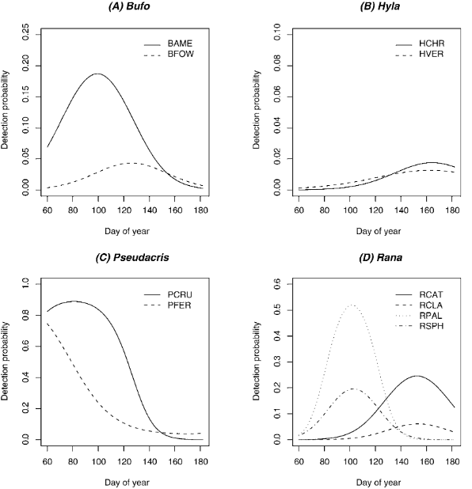
You cannot ignore imperfect detection

Slide 16
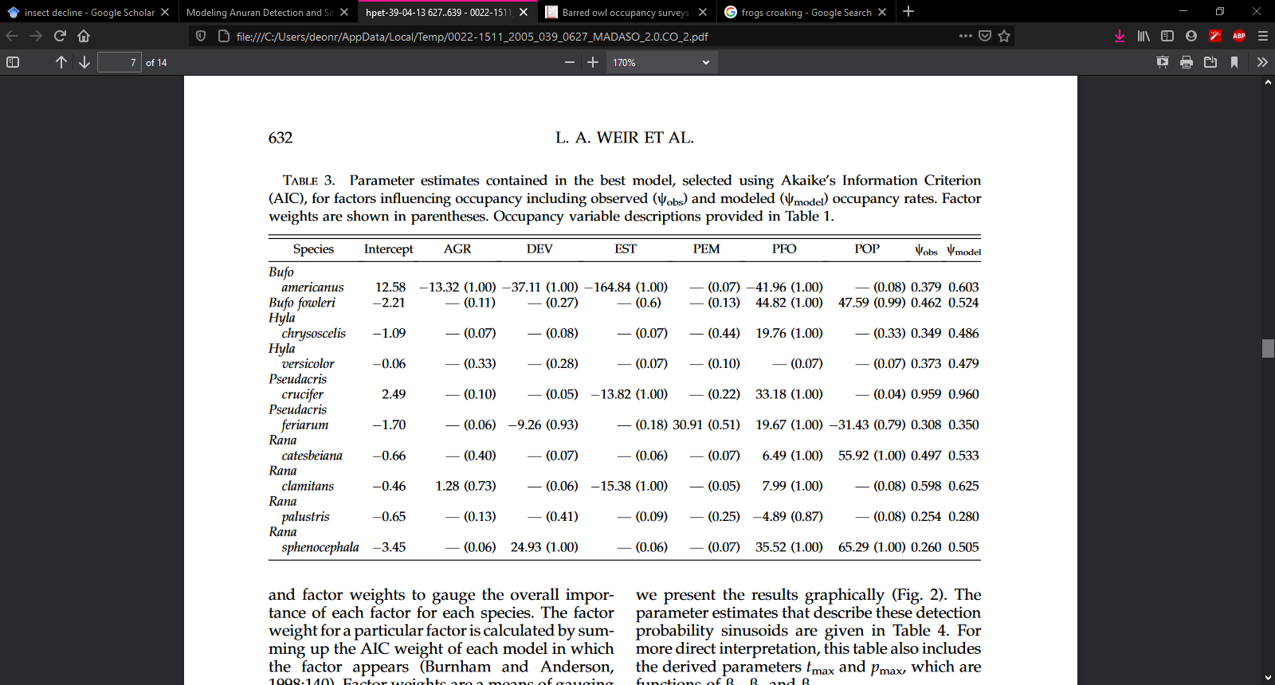
What influenced occupancy?
Taking imperfect detection into account ($ψ_{model}$)always showed greater occupancy compared to naive estimates of occupancy ($ψ_{obs}$)

Slide 17
What do they suggest based on their results?
Implications for surveying:
None of the variables collected by NAAMP were influential for all species
You could drop these from future monitoring
But they suggest not to because some are important for some species
Additional data could be important and should be included
Include variables that can affect detection!
Temperature varies detection, so sample when temperatures are appropriate
Refine sampling design
Implications for anuran population decline:
Ignoring imperfect detection can lead to inferences that anurans are declining

